Slide 1
8-Puzzle Problem
Using BFS and DFS
Team members:
1. Harita Joshi 2. Janhavi Gundawar 3. Ritesh Bagade

Slide 2

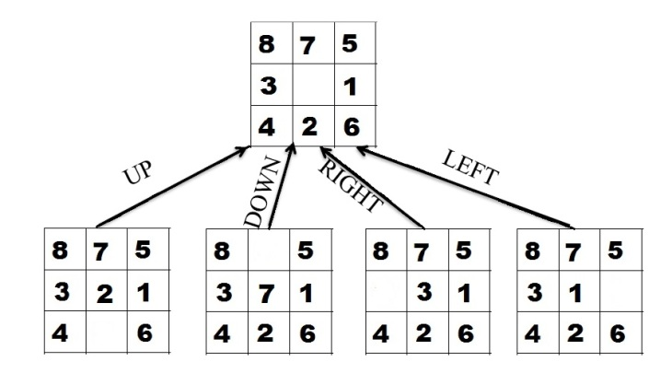
What is 8-puzzle problem?
The 8-puzzle problem is a classic search problem in artificial intelligence. It was invented and popularized by Noyes Palmer Chapman in the 1870s.
Given a 3×3 board with 8 tiles (each numbered from 1 to 8) and one empty space, the goal is to place the numbers to match the final configuration using the empty space. We can slide four adjacent tiles (left, right, above, and below) into the empty space.
Initial State
Goal State
The starting position of the tiles on the grid.
The desired arrangement of tiles on the grid.
Valid Moves
Sliding a tile into the empty space, moving the blank tile to an adjacent position.

Slide 3
Search Strategies
Search strategy refers to the method used to explore the possible states of the 8-puzzle to find a solution. Each state represents a different configuration of the puzzle.
The goal is to find a path from the initial state (starting configuration) to the goal state (target configuration) by moving the empty space to achieve the correct arrangement of tiles.
Types of Search
Breadth-First Search
Depth-First Search
Explores all possible moves level by level, starting from the initial state.
Explores each path as deeply as possible before backtracking and trying another path.

Slide 4
Breadth-First Search (BFS) Approach
Algorithm
1
Queue-based
1
Start from the root node
2
Explore all neighboring nodes at the present
3
Move to the next depth level and repeat the
4
If a goal state is reached, return the solution
depth
process
BFS uses a queue to keep track of the next states to explore.
2
Expanded States
It explores all possible moves from the current state before moving to the next level.
3
Optimal Solution
BFS is guaranteed to find the shortest path to the goal state, if it exists.

Slide 5
BFS Approach
Initial State
 | 2 | 3
1 | 8 | 4
7 | 5 | 6
1
Initial State
 | 2 | 3
1 | 8 | 4
7 | 5 | 6
2 |  | 3
1 | 8 | 4
7 | 6 | 5
1 | 2 | 3
 | 8 | 4
7 | 6 | 5
2
3
Final State
1 | 2 | 3
8 |  | 4
7 | 6 | 5
2 | 8 | 3
1 |  | 4
7 | 6 | 7
2 | 3
1 | 8 | 4
7 | 6 | 5
1 | 2 | 3
8 |  | 4
7 | 6 | 5
1 | 2 | 3
7 | 8 | 4
 | 6 | 5
4
5
6
7
Goal State

Slide 6
Depth-First Search (DFS) Approach
Algorithm
1
Stack-based
1
2
Explore the leftmost child node recursively until you
3
If a goal state is reached, return the solution
4
If a leaf node is reached without finding a solution,
reach a leaf node or a goal state
backtrack to explore other branches
Start from the root node
DFS uses a stack to keep track of the path being explored.
2
Path Exploration
It explores one path as far as possible before backtracking and trying a different path.
3
Memory Efficiency
DFS can be more memory-efficient than BFS, as it doesn't need to store all possible states.

Slide 7
Initial State
1 | 2 | 3
 | 4 | 6
7 | 5 | 8
DFS Approach
1
1 | 2 | 3
4 |  | 6
7 | 5 | 8
 | 2 | 3
1 | 4 | 6
7 | 5 | 8
1 | 2 | 3
7 | 4 | 6
 | 5 | 8
Initial State
2
1 | 2 | 3
 | 4 | 6
7 | 5 | 8
1 | 2 | 3
4 | 5 | 6
7 |  | 8
1 |  | 3
4 | 2 | 6
7 | 5 | 8
1 | 2 | 3
4 | 6
7 | 5 | 8
2 |  | 3
1 | 4 | 6
7 | 5 | 8
1 | 2 | 3
7 | 4 | 6
5 |  | 8
3
Final State
1 | 2 | 3
4 | 5 | 6
7 | 8
1 | 2 | 3
4 | 5 | 6
7 | 8
1 | 2 | 3
4 | 5 | 6
 | 7 | 8
1 | 2 | 3
4 |  | 6
7 | 5 | 8
4
Goal State

Slide 8
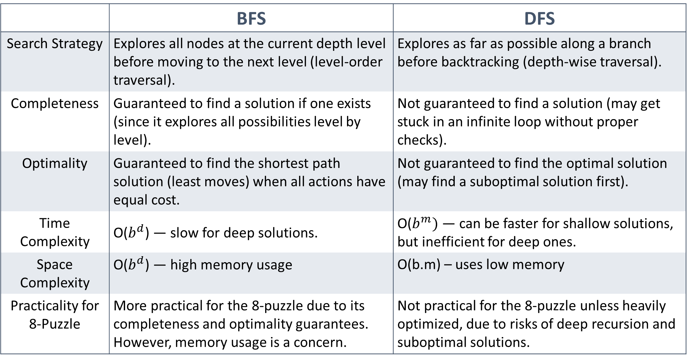
BFS vs DFS
 | BFS | DFS
Search Strategy | Explores all nodes at the current depth level before moving to the next level (level-order traversal). | Explores as far as possible along a branch before backtracking (depth-wise traversal).
Completeness | Guaranteed to find a solution if one exists (since it explores all possibilities level by level). | Not guaranteed to find a solution (may get stuck in an infinite loop without proper checks).
Optimality | Guaranteed to find the shortest path solution (least moves) when all actions have equal cost. | Not guaranteed to find the optimal solution (may find a suboptimal solution first).
Time Complexity | O($b^{d}$) — slow for deep solutions. | O($b^{m})$ — can be faster for shallow solutions, but inefficient for deep ones.
Space Complexity | O($b^{d}$) — high memory usage | O(b.m) – uses low memory
Practicality for 8-Puzzle | More practical for the 8-puzzle due to its completeness and optimality guarantees. However, memory usage is a concern. | Not practical for the 8-puzzle unless heavily optimized, due to risks of deep recursion and suboptimal solutions.

Slide 9
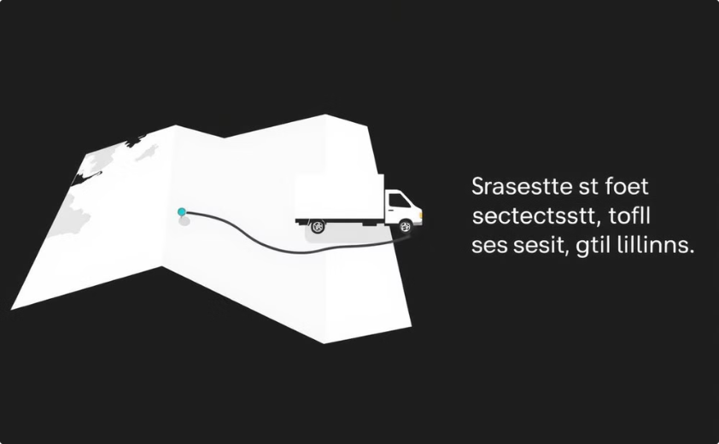

Real - life Applications
The 8-puzzle problem has applications in robotics, logistics, and resource allocation. Finding efficient paths for robots, optimizing warehouse layouts, and scheduling tasks are all related to this problem.
Route Optimization
Robotics
Finding the most efficient routes for delivery vehicles.
Planning and executing complex movements for robotic arms.

